Slide 1

CREATE
YOUR
Club BUDGET

Slide 2
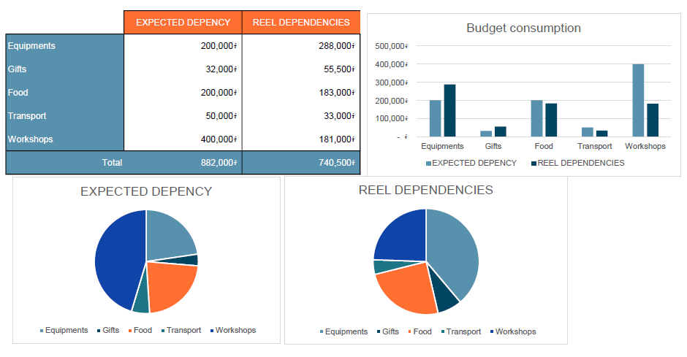
A budget is a piece of content designed to help you keep track of your expenses and not spend a projected budget.

Slide 3
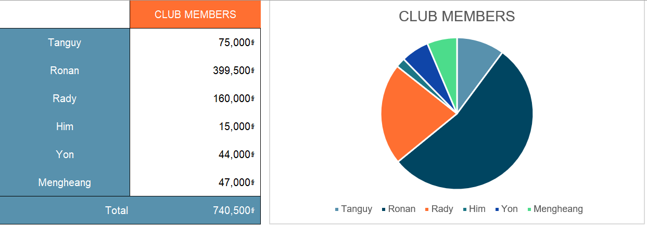
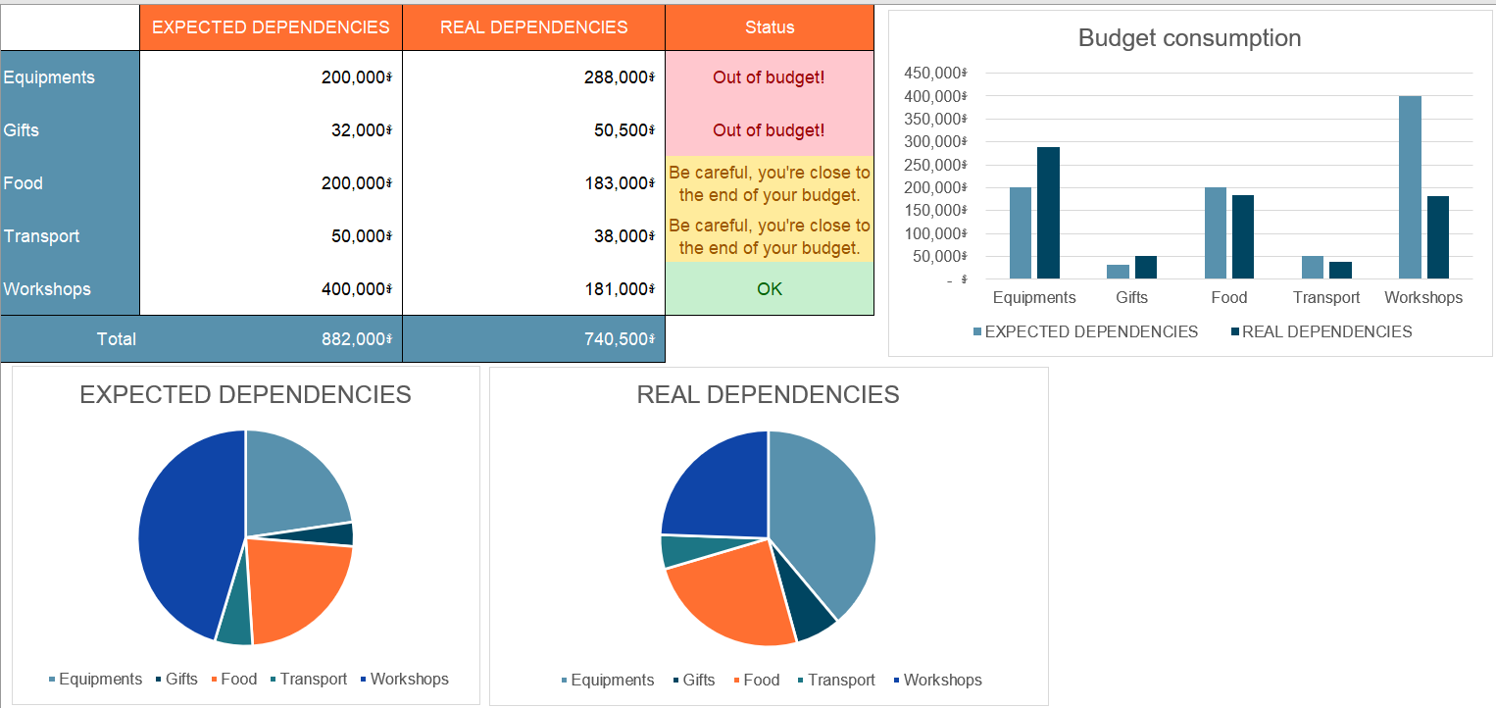
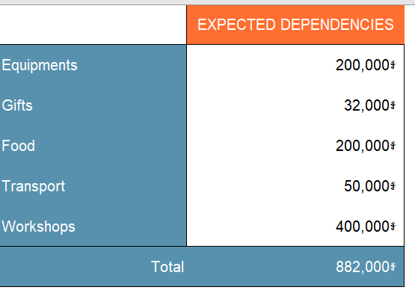
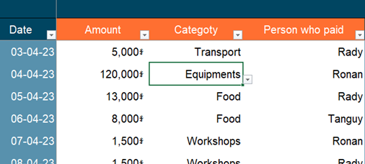
Your club budget
1 – Summary sheet
2 – Expected dependencies
4 – Reel dependencies
3 – Club members

Slide 4
1 – Summary sheet
Displays:
“Out-of-budget" if expenses are higher than forecast
"Be careful, you're close to the end of your budget" if there is less than $5 left in the budget.
"OK" if all is well
Sum the total of each category
(from Real dependencies sheet)
Notes:
Use a pie chart to display the distribution of expected and real dependencies
Use bar chart to compare easily the distribution of expected and real dependencies
Expected dependencies data are references from the Expected dependencies sheet

Slide 5
2 – Expected dependencies
The (unique) list of categories
Total of expected dependencies
Notes:
The category list is used for the category drop-down list.

Slide 6
3 – Club members dependencies
The sum of payments made by each member
The (unique) list of cub members
Notes:
Use a pie chart to display the distribution of club members' dues
The total of each member comes from the sum of his payments in the Real dependencies sheet
The list of the member is used for the member dropdown list

Slide 7
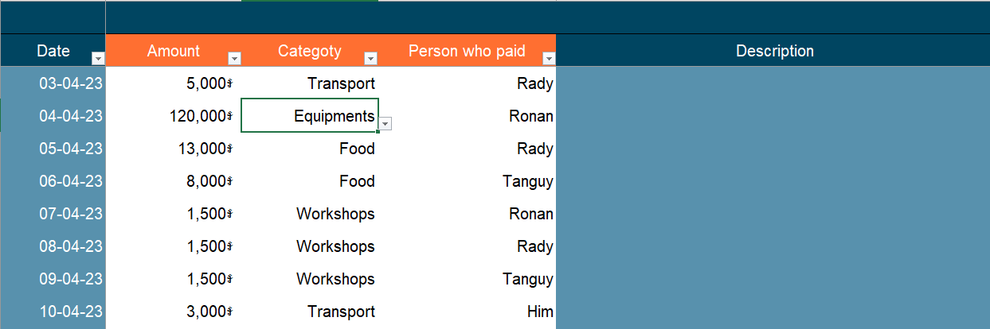
4 – Real dependencies
Notes:
Sort by amount, category or payer
Use a list to select category or member
Use riel as currency symbol

Slide 8
Project timeline
JUNE 01
JUNE 12
Reel dependencies
sheet
Club members
sheet
Expected dependencies
sheet
Summary
sheet

Slide 9

Evaluation
This is your evaluation of
MS EXCEL

